Slide 1

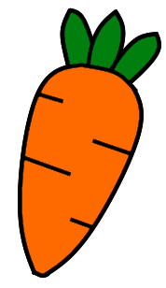
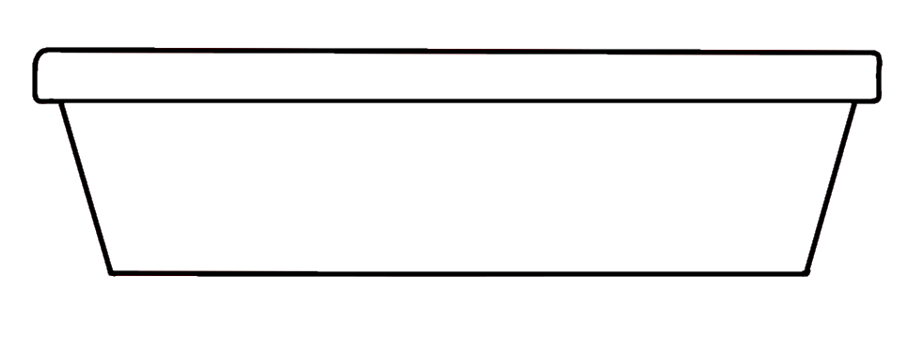
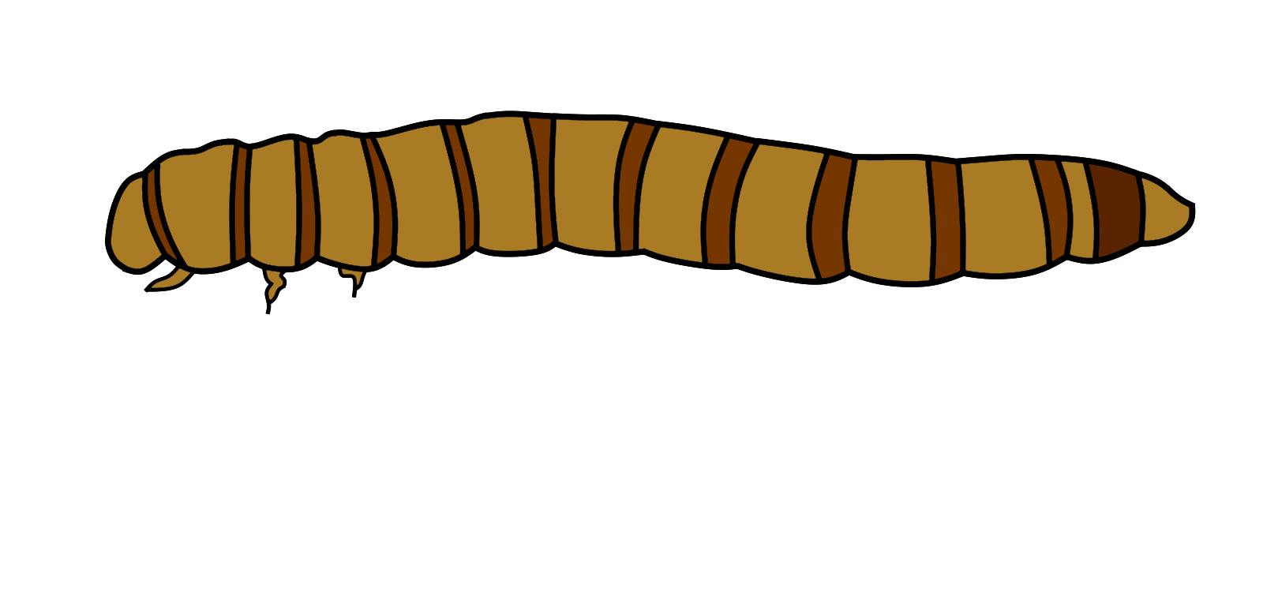
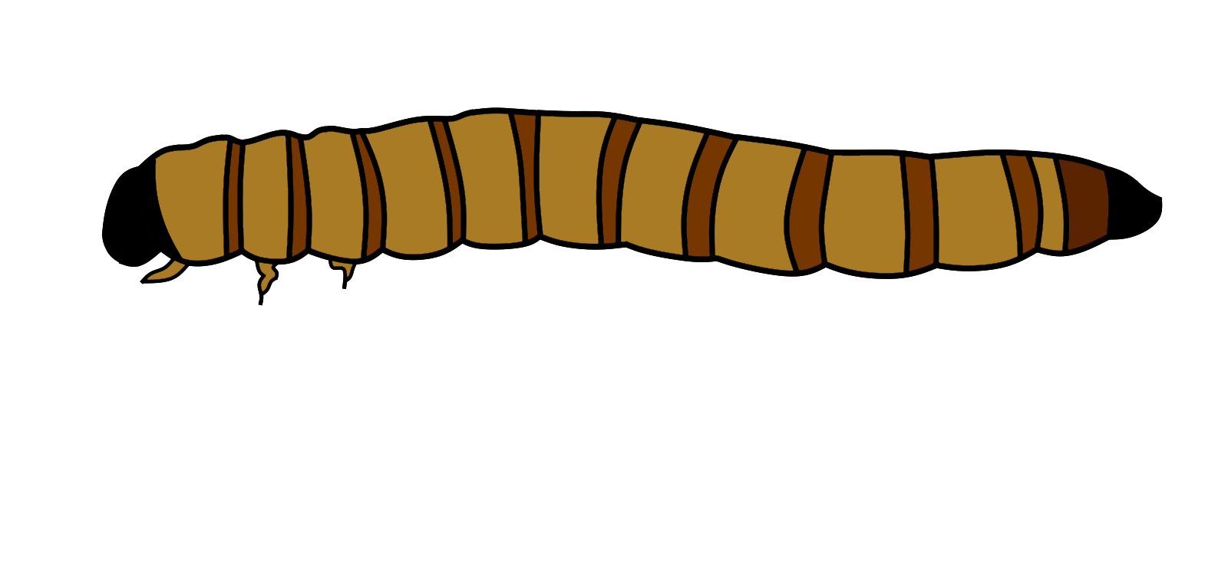
Treatments
1
2
3
4
5
6
7
8
Phase 1
Frass
Phase 2
Key
Oats 2 g / 7 days
Carrot 2 g / 3 days
0.51 g PVC foam square
Tenebrio molitor
Zophobas atratus

